Slide 1
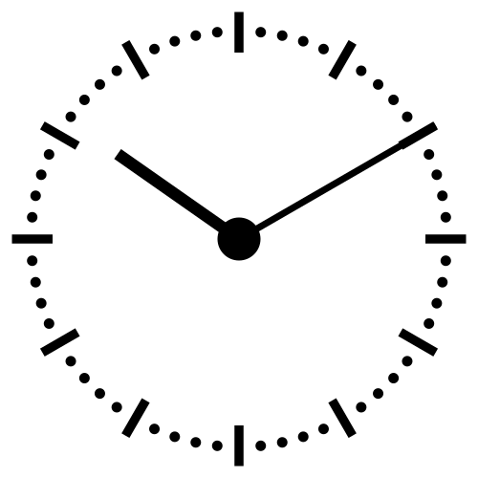
The Fourth Hour!
Welcome to…

Slide 2
Introduction
Welcome to the Fourth Hour!
Name
Professor
A fun fact about you

Slide 3
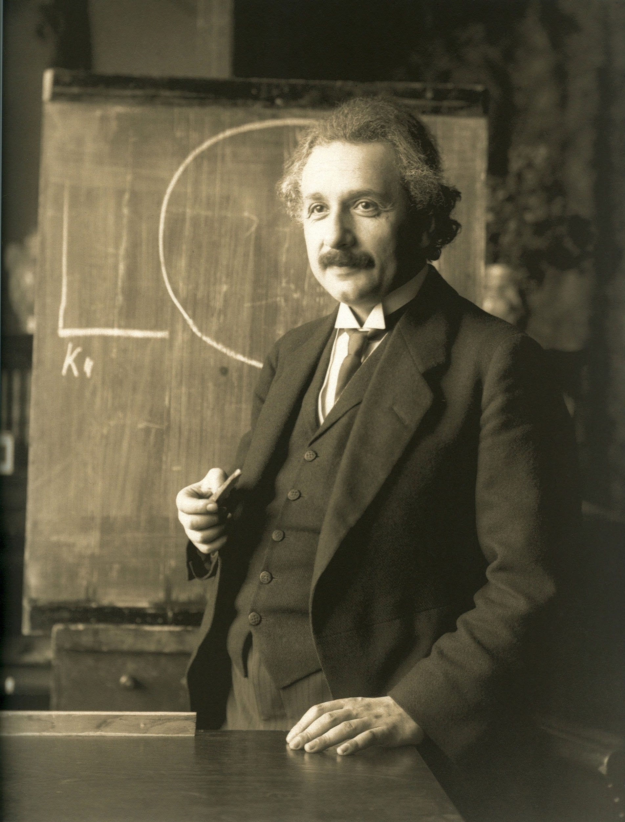
“Anyone who has never made a mistake has never tried anything new.”

Slide 4
Functions
Functions can be used to avoid code duplication
Why does this matter?

Slide 5
Functions
Functions can be used to avoid code duplication
Why does this matter?
Avoiding code duplication makes code easier to debug and maintain.
It can also make code easier to read and understand.
Notes:
explain stuff like If you fix a bug in a function it immediately gets fixed everywhere the function is called etc etc

Slide 6
Defining and Using Functions
The part of the program that creates a function is called the function definition
A function definition looks like this:
def function_name(<parameters>):
<body>
Using a function (or more formally calling or invoking a function) is done by typing the function name followed by the values to substitute into the parameters in parentheses. These values in the call are referred to as arguments.
function_name(<arguments>)
Notes:
make sure they know <body> and <parameter> are supposed to be substituted

Slide 7
Review
Login to Socrative at https://b.socrative.com/login/student/
Use code 4thHour149

Slide 8
Question 1 - PI
Which of the following contains a function call:
type(4.5)
def add_one(x):
return x + 1
area(2,9)
print(“Hello”)
3
2 and 3
1, 3, and 4
All of them

Slide 9
Question 1 - PI
Which of the following contains a function call:
type(4.5)
def add_one(x):
return x + 1
area(2,9)
print(“Hello”)
3
2 and 3
1, 3, and 4
All of them

Slide 10
Question 2
For example if we have the following function:
def myFunc(word):
print(“My word is”, word)
How would we call this function?
myFunc(“Hamburger”)
myFunc()
myFunc(word)
ERROR

Slide 11
Question 2
For example if we have the following function:
def myFunc(word):
print(“My word is”, word)
How would we call this function?
myFunc(“Hamburger”)
myFunc()
myFunc(word)
ERROR

Slide 12
Defining and Using Functions
For example if we have the following function:
def myFunc(word):
print(“My word is”, word)
How would we call this function?
myFunc(“Hamburger”)
My word is Hamburger

Slide 13
Parameters and Arguments
Parameters and arguments are a way to move data between functions.
The difference between the two is that parameters are given the values of the arguments and then the statements in the body of the function are executed.
def function(<parameters>):
<body>
While arguments are used when the function is called/invoked.
function(<arguments>)
Notes:
Explain this in plain english as this is a little wordy. “So as you can see in the function definition…. and when the function is invoked…”

Slide 14
Question 3 - PI
def myFunc(word):
print(word)
def main():
word = “Toast”
myFunc(“Hamburger”)
What prints when main() is run?
Hamburger
Toast
HamburgerToast
ERROR

Slide 15
Question 3 - PI
def myFunc(word):
print(word)
def main():
word = “Toast”
myFunc(“Hamburger”)
What prints when main() is run?
Hamburger
Toast
HamburgerToast
ERROR

Slide 16
Parameters and Arguments
Like other variables used in the function, parameters are only used inside the body of the function.
Even if there are variables with the same name in the program, the function ignores these and only uses the variables passed or declared in it.
Notes:
**TLDR: Draw a stack diagram for last slide/question**
This is when it is good to draw a memory stack diagram to illustrate what is happening. Show them that there are two separate values. I sometimes make the analogy to there being two Ryan's or whatever the most common name is in my class, and that the function is like the last or family name that differentiates between the two. Then I also would make sure to introduce the vocabulary of the word scope (as in the scope of a variable is where it has meaning), which is just inside its function.

Slide 17
Practice
Write a function called trippler that takes a number as a parameter, multiplies it by 3, and prints the result.

Slide 18
Practice
Write a function called trippler that takes a number as a parameter, multiplies it by 3, and prints the result.
def trippler(num):
num = num * 3
print(num)
How would we call it?
Notes:
they can also do something like this - it works in python you CAN change the val in parameter
def trippler(num):
num = num * 3
print(num)
Try this example in Python Tutor

Slide 19
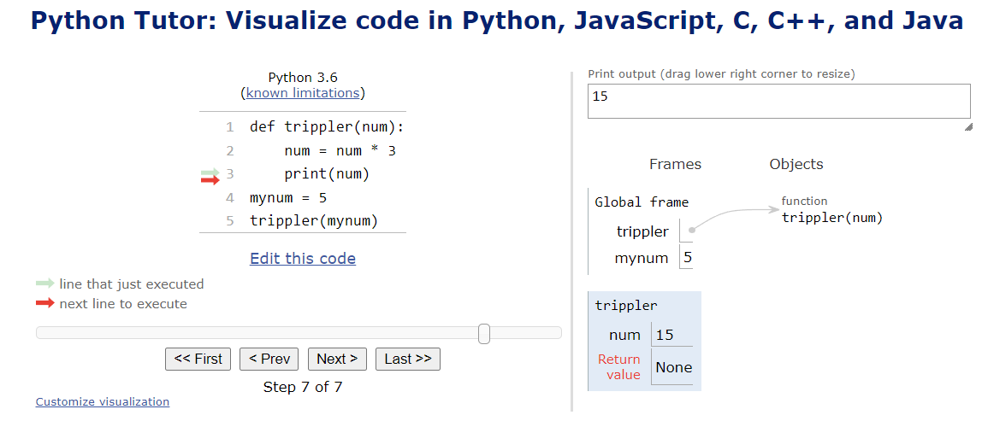

Slide 20
Practice
Write a function called trippler that takes a number as a parameter, multiplies it by 3, and prints the result.
def trippler(num):
num = num * 3
print(num)
How would we call it?
trippler(2)
6
Notes:
they can also do something like this - it works in python you CAN change the val in parameter
def trippler (num):
num = num * 3
print(num)

Slide 21
Return Statements
Now that we know how to pass data into a function, how do we get it out?
We use return statements!
Once python encounters “return” it exits the function and passes the data in the return statement
The code in the calling program will then continue to execute as normal

Slide 22
Question 4
def test(num):
print(num)
return num + 1
print(num + 2)
def main():
print(test(0))
What prints when main() is run?
*assume spaces are newlines
0 1 2
0 2 1
0 1
ERROR

Slide 23
Question 4
def test(num):
print(num)
return num + 1
print(num + 2)
def main():
print(test(0))
What prints when main() is run?
*assume spaces are newlines
0 1 2
0 2 1
0 1
ERROR

Slide 24
Return Statements
Let’s modify the trippler function to return instead of print its value.
Notes:
Walk them through this

Slide 25
Return Statements
Let’s modify the trippler function to return instead of print its value.
def trippler(num):
return num * 3
To get the tripled number out of this function we must save it in a variable
Notes:
Walk them through this

Slide 26
Return Statements
Let’s modify the trippler function to return instead of print its value.
def trippler(num):
return num * 3
To get the tripled number out of this function we must save it in a variable
newNum = trippler(3)
print(newNum)
9
Notes:
Walk them through this

Slide 27
Activity
Consider this code:
import math
print("The area of circle with radius 5 is ", math.pi * 5 ** 2)
print("The area of circle with radius 8 is ", math.pi * 8 ** 2)
print("The area of circle with radius 2 is ", math.pi * 2 ** 2)
Eliminate the redundancy in this code by defining an area function and calling it three times.
Notes:
Just do this on the board

